Slide 1
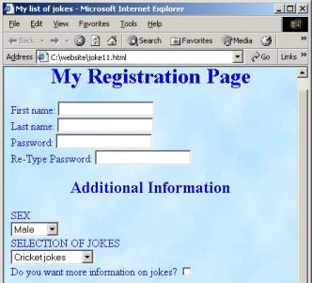
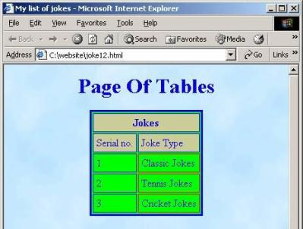


HTML 5 – Tables, Forms and Frames
Doncho Minkov
Technical Trainer
http://minkov.it
Telerik School Academy
http://schoolacademy.telerik.com

Slide 2

Contents
HTML Tables
Simple Tables
Complete HTML 5 Tables
Data cells and Header cells
Nested Tables
Complex tables
Cells Width
Cell Spacing and Padding
Column and Row Span

Slide 3


Contents (2)
HTML Forms
Form Fields and Fieldsets
Text boxes
Buttons
Checkboxes and Radio Buttons
Select fields
Hidden fields
Sliders and Spinboxes
Validation fields

Slide 4


Contents (3)
HTML Frames
Frame and Noframe tags
IFrames

Slide 5
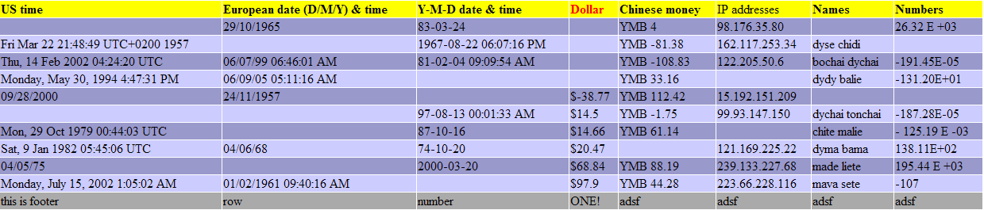
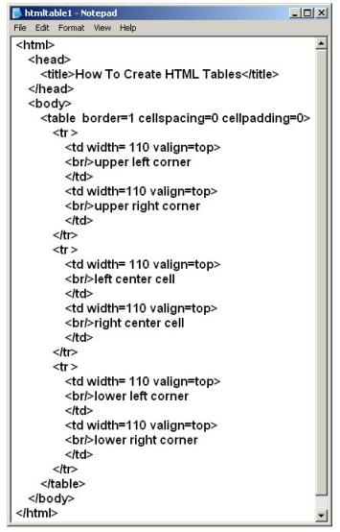
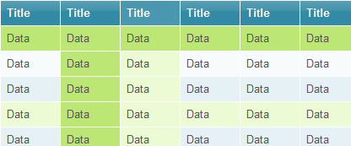
HTML Tables

Slide 6
HTML Tables
Tables represent tabular data
A table consists of one or several rows
Each row has one or more columns
Tables comprised of several core tags: <table></table>: begin / end the table <tr></tr>: create a table row <td></td>: create tabular data (cell)
Tables should not be used for layout. Use CSS floats and positioning styles instead

Slide 7
Simple HTML Tables – Example
<table cellspacing="0" cellpadding="5">
<tr>
<td><img src="ppt.gif"></td>
<td><a href="lecture1.ppt">Lecture 1</a></td>
</tr>
<tr>
<td><img src="ppt.gif"></td>
<td><a href="lecture2.ppt">Lecture 2</a></td>
</tr>
<tr>
<td><img src="zip.gif"></td>
<td><a href="lecture2-demos.zip">
Lecture 2 - Demos</a></td>
</tr>
</table>

Slide 8

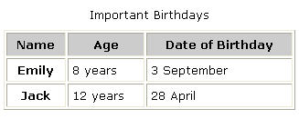

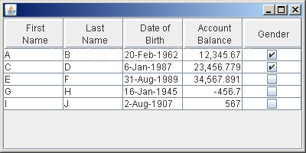
Simple HTML Tables
Live Demo

Slide 9
Data Cells and Header Cells
Two kinds of cells in HTML 5 tables
Data cells – containing the table data
Header cells – used for the column names or some more important cells in a table
Why two kinds of cells?
Used to semantically separate the cells
<tr>
<th>Full name</th> <th> Mark </th>
</tr>
<tr>
<td>Doncho Minkov</td> <td>Very good 5</td>
</tr>
<tr>
<td>Georgi Georgiev</td> <td>Exellent 6</td>
</tr>

Slide 10


Data and Header Cells
Live Demo

Slide 11

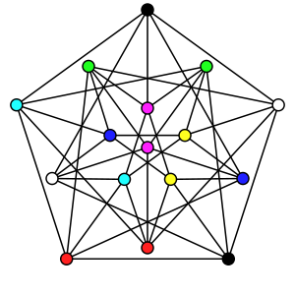

Complete HTML 5 Tables
With Header, Footer and Body

Slide 12
Complete HTML Tables
Table rows split into three semantic sections: header, body and footer
<thead> denotes table header and contains <th> elements, instead of <td> elements
<tbody> denotes collection of table rows that contain the very data
<tfoot> denotes table footer but comes BEFORE the <tbody> tag
<colgroup> and <col> define columns (used to set column widths)

Slide 13
Complete HTML Table: Example
<table>
<colgroup>
<col style="width:100px" /><col />
</colgroup>
<thead>
<tr><th>Column 1</th><th>Column 2</th></tr>
</thead>
<tfoot>
<tr><td>Footer 1</td><td>Footer 2</td></tr>
</tfoot>
<tbody>
<tr><td>Cell 1.1</td><td>Cell 1.2</td></tr>
<tr><td>Cell 2.1</td><td>Cell 2.2</td></tr>
</tbody>
</table>
columns
header
th
footer
Last comes the body (data)

Slide 14
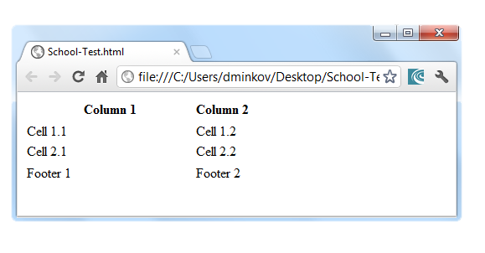
Complete HTML Table: Example (2)
<table>
<colgroup>
<col style="width:200px" /><col />
</colgroup>
<thead>
<tr><th>Column 1</th><th>Column 2</th></tr>
</thead>
<tfoot>
<tr><td>Footer 1</td><td>Footer 2</td></tr>
</tfoot>
<tbody>
<tr><td>Cell 1.1</td><td>Cell 1.2</td></tr>
<tr><td>Cell 2.1</td><td>Cell 2.2</td></tr>
</tbody>
</table>
table-full.html
Although the footer is before the data in the code, it is displayed last

Slide 15
Complete HTML 5 Tables
Live Demo

Slide 16
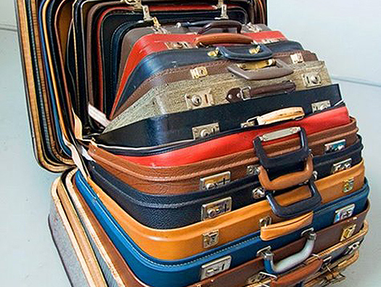

Nested Tables
Tables in Tables in Tables in Tables…

Slide 17
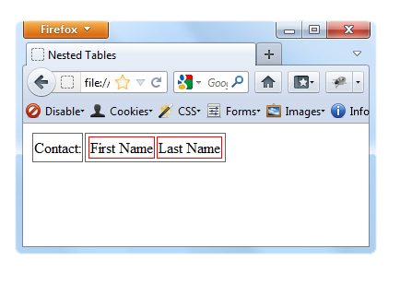
Nested Tables
Table "cells" (<td>) can contain nested tables (tables within tables):
nested-tables.html
<table>
<tr>
<td>Contact:</td>
<td>
<table>
<tr>
<td>First Name</td>
<td>Last Name</td>
</tr>
</table>
</td>
</tr>
</table>

Slide 18
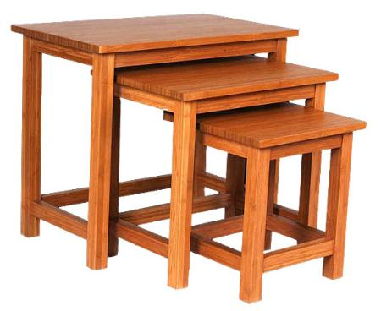
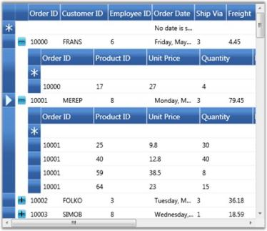
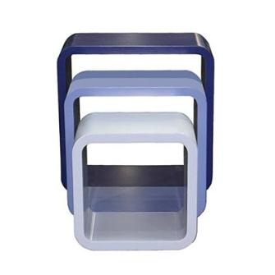
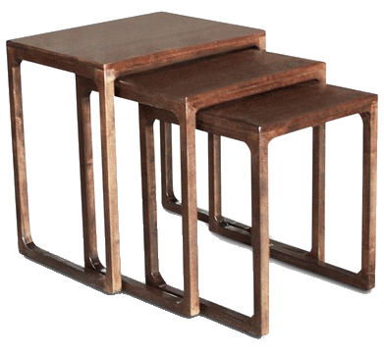
Nested Tables
Live Demo

Slide 19

Complex Tables
With Padding, Spacing and Stuff

Slide 20
Cell Spacing and Padding
Tables have two attributes related to space
cellspacing
Defines the empty space between cells
cellpadding
Defines the empty space around the cell content
cell
cell
cell
cell
cell
cell
cell
cell

Slide 21
Cell Spacing and Padding – Example
table-cells.html
<html>
<head><title>Table Cells</title></head>
<body>
<table cellspacing="15" cellpadding="0">
<tr><td>First</td>
<td>Second</td></tr>
</table>
<br/>
<table cellspacing="0" cellpadding="10">
<tr><td>First</td><td>Second</td></tr>
</table>
</body>
</html>

Slide 22
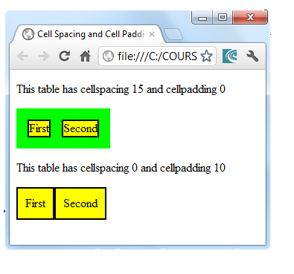
Cell Spacing and Padding – Example (2)
table-cells.html
<html>
<head><title>Table Cells</title></head>
<body>
<table cellspacing="15" cellpadding="0">
<tr><td>First</td>
<td>Second</td></tr>
</table>
<br/>
<table cellspacing="0" cellpadding="10">
<tr><td>First</td><td>Second</td></tr>
</table>
</body>
</html>

Slide 23
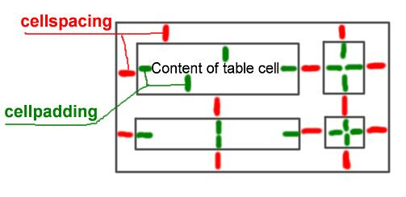
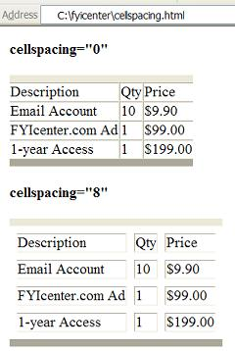
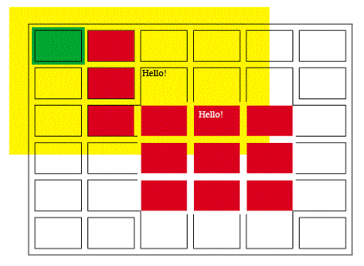
Table Cell Spacing and Cell Padding
Live Demo

Slide 24



Row and Column Spans
How to make a two-cells column? Or row?

Slide 25
Column and Row Span
Cells have two attributes related to merging
colspan
Defines how many columns the cell occupies
rowspan
Defines how many rows the cell occupies
colspan="1"
colspan="1"
rowspan="2"
rowspan="1"
cell[1,1]
cell[1,2]
cell[1,1]
cell[1,2]
cell[2,1]
cell[2,1]
colspan="2"
rowspan="1"

Slide 26
Column and Row Span – Example
table-colspan-rowspan.html
<table cellspacing="0">
<tr class="1"><td>Cell[1,1]</td>
<td colspan="2">Cell[2,1]</td></tr>
<tr class="2"><td>Cell[1,2]</td>
<td rowspan="2">Cell[2,2]</td>
<td>Cell[3,2]</td></tr>
<tr class="3"><td>Cell[1,3]</td>
<td>Cell[2,3]</td></tr>
</table>

Slide 27
Column and Row Span – Example (2)
table-colspan-rowspan.html
<table cellspacing="0">
<tr class="1"><td>Cell[1,1]</td>
<td colspan="2">Cell[2,1]</td></tr>
<tr class="2"><td>Cell[1,2]</td>
<td rowspan="2">Cell[2,2]</td>
<td>Cell[3,2]</td></tr>
<tr class="3"><td>Cell[1,3]</td>
<td>Cell[2,3]</td></tr>
</table>
Cell[1,1]
Cell[2,1]
Cell[1,2]
Cell[2,2]
Cell[3,2]
Cell[1,3]
Cell[2,3]

Slide 28
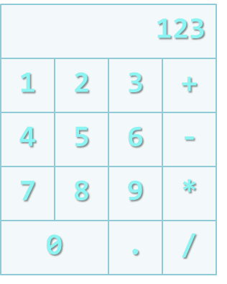
Row and Columns Spans
Live Demo

Slide 29
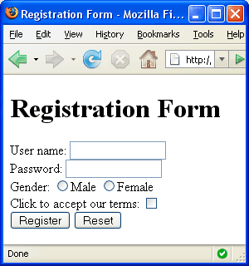


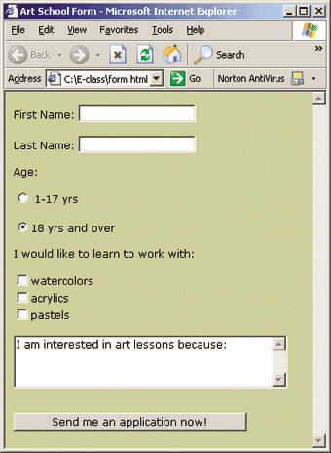
HTML 5 Forms
Entering User Data from a Web Page

Slide 30
What are HTML 5 Forms?
The primary method for gathering data from site visitors
HTML 5 Forms can contain
Text fields for the user to type
Buttons for interactions like "Register", "Login", "Search"
Menus, Sliders, etc…
Check Google, Yahoo, Facebook
Google search field is a simple Text field

Slide 31
How to Create Forms?
Create a form block with
Example:
The "method" attribute tells how the form data should be sent – via GET or POST request
<form></form>
<form name="myForm" method="post" action="path/to/some-script.php">
...
</form>
The "action" attribute tells where the form data should be sent

Slide 32
Text Fields
Single-line text input fields:
Multi-line text input fields (textarea):
Password input – a text field which masks the entered text with * signs
<input type="text" name="FirstName" value="This is a text field" />
<textarea name="Comments">This is a multi-line text field</textarea>
<input type="password" name="pass" />

Slide 33
Buttons
Reset button – brings the form to its initial state
Submit button:
Image button – acts like submit but image is displayed and click coordinates are sent
Ordinary button – no default action, used with JS
<input type="reset" name="resetBtn" value="Reset the form" />
<input type="submit" value="Apply Now" />
<input type="image" src="submit.gif" name="submitBtn" alt="Submit" />
<input type="button" value="click me" />

Slide 34
Checkboxes and Radio Buttons
Checkboxes:
Radio buttons:
Radio buttons can be grouped, allowing only one to be selected from a group:
<input type="checkbox" name="fruit" value="apple" />
<input type="radio" name="title" value="Mr." />
<input type="radio" name="city" value="Lom" />
<input type="radio" name="city" value="Ruse" />

Slide 35
Select Fields
Dropdown menus:
Multiple-choice menus
<select name="gender">
<option value="Value 1"
selected="selected">Male</option>
<option value="Value 2">Female</option>
<option value="Value 3">Other</option>
</select>
<select name="products" multiple="multiple">
<option value="Value 1"
selected="selected">keyboard</option>
<option value="Value 2">mouse</option>
</select>

Slide 36
Hidden Fields
Hidden fields contain invisible data
Not shown to the user
Used by JavaScript and server-side code
ViewState, SessionState, etc..
<input type="hidden" name="Account" value="This is a hidden text field" />

Slide 37
Labels
Labels are used to associate an explanatory text to a form field using the field's ID.
Clicking on a label focuses its associated field (checkboxes are toggled, radio buttons are checked)
Labels are both a usability and accessibility feature and are required in order to pass accessibility validation.
<label for="fn">First Name</label>
<input type="text" id="fn" />

Slide 38
Fieldsets
Fieldsets are used to enclose a group of related form fields:
The <legend> is the fieldset's title.
<form method="post" action="form.aspx">
<fieldset>
<legend>Client Details</legend>
<input type="text" id="Name" />
<input type="text" id="Phone" />
</fieldset>
<fieldset>
<legend>Order Details</legend>
<input type="text" id="Quantity" />
<textarea cols="40" rows="10" id="Remarks"></textarea>
</fieldset>
</form>

Slide 39




HTML 5 Forms Inputs Fields
Live Demo

Slide 40


Sliders and Spinboxes
Lets make it spin

Slide 41
Range and Spinbox
Restricts users to enter only numbers
Additional attributes min, max and step and value
Can become Spinbox or Slider, depending on the input type
Have some differences on different browsers
Sliders and Spinboxes do not work on Firefox
Shown as regular textboxes
<input type="range" min="0" max="100" />
<input type="number" min="0" max="100" />

Slide 42

Sliders and Spinboxes
Live Demo

Slide 43
Attributes from HTML 5
Autocomplete
The browser stores the previously typed values
Brings them back on a later visit on the same page
Autofocus
The field becomes on focus on page load
Required
The field is required to be filled/selected

Slide 44
Input Fields with Validation
Email – provides a simple validation for email
Can be passed a pattern for validation
On a mobile device brings the email keyboard
URL – has validation for url
On a mobile device brings the url keyboard
Telephone
Brings the numbers keyboard
<input type="email" required="true" pattern="[^ @]*@[^ @].[^ @]"/>
<input type="url" required="true" />
<input type="tel" required="true" />

Slide 45


HTML Forms Validation
Live Demo

Slide 46
TabIndex
The tabindex HTML attribute controls the order in which form fields and hyperlinks are focused when repeatedly pressing the TAB key
tabindex="0" (zero) - "natural" order
If X < Y, then elements with tabindex="X" are iterated before elements with tabindex="Y"
Elements with negative tabindex are skipped, however, this is not defined in the standard
<input type="text" tabindex="10" />

Slide 47


Tab Index
Live Demo

Slide 48
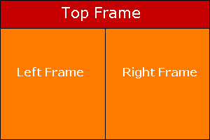
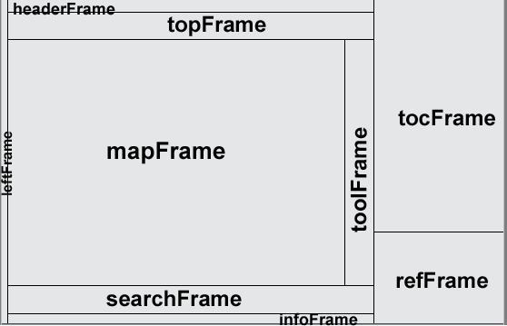
HTML Frames
<frameset>, <frame> and <iframe>

Slide 49
HTML Frames
Frames provide a way to show multiple HTML documents in a single Web page
The page can be split into separate views (frames) horizontally and vertically
Frames were popular in the early ages of HTML development, but now their usage is rejected
Frames are not supported by all user agents (browsers, search engines, etc.)
A <noframes> element is used to provide content for non-compatible agents.

Slide 50
HTML Frames – Demo
frames.html
<html>
<head><title>Frames Example</title></head>
<frameset cols="180px,*,150px">
<frame src="left.html" />
<frame src="middle.html" />
<frame src="right.html" />
</frameset>
</html>
Note the target attribute applied to the <a> elements in the left frame.

Slide 51
Inline Frames: <iframe>
Inline frames provide a way to show one website inside another website:
iframe-demo.html
<iframe name="iframeGoogle" width="600" height="400" src="http://www.google.com" frameborder="yes" scrolling="yes"></iframe>

Slide 52
HTML – Tables and Forms
?
?
?
?
?
Questions?
?
?
?
?
?
http://schoolacademy.telerik.com

Slide 53
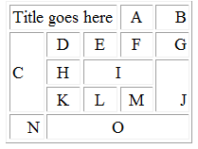
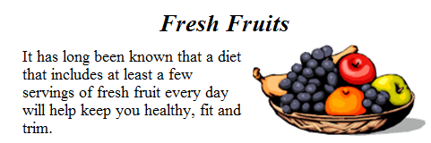
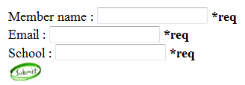
Homework
Create Web Pages like the following using tables:
Create a Web Page like the following using forms:

Slide 54
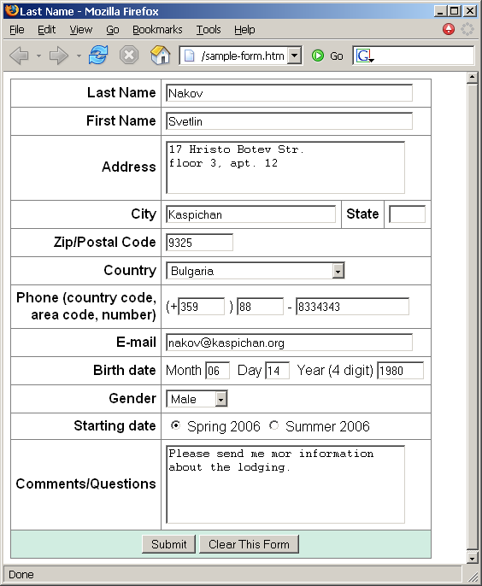
Homework (2)
Create a Web form that looks like this sample:

Slide 55
Homework (3)
Create a Calculator-like table. You should use a HTML 5 form for the Calculator
Buttons for all the numbers and operators (+, -, etc.)
Textbox for the result
Do not make the same styles as the example.

Slide 56
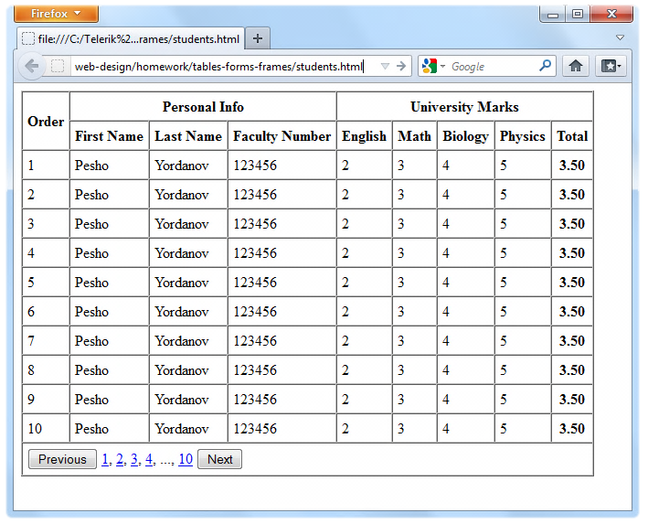
Homework (4)
Create the following using tables and forms:

Slide 57
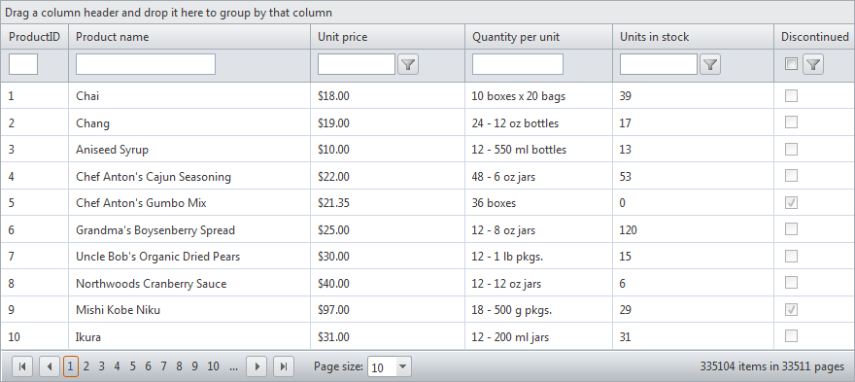
Homework (5)
Construct the following Grid component:
Try to make a HTML page, that looks just like the example
Not required to style for the homework

Slide 58
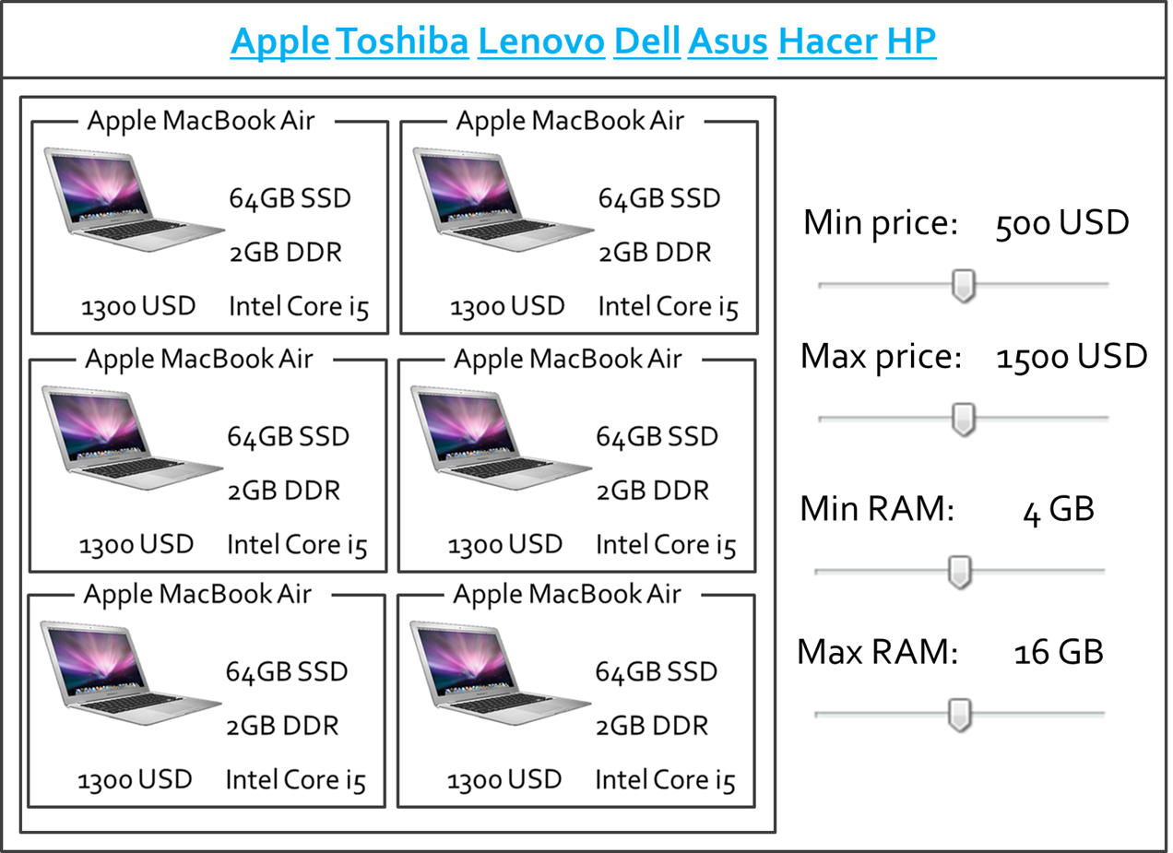
Homework (7)
Create the following HTML 5 Page
Hint: Use Fieldsets and Nested tables

